Slide 1

Index (x): Prescriptions for Performance Improvement
Find presentation, Excel spreadsheet, & T-SQL code at
https://github.com/SQLXL/SQLXL
SQL Saturday Jacksonville 2024
Bill Sanscrainte
Bill@Sanscrainte.com
Notes:
*00:00*

Slide 2


















Thank you to ALL of our sponsors! - Be sure to stop by all tables!
AI Platinum
Gold
Platinum
Silver
Bronze
In-Kind

Slide 3

Monthly Meetings 3rd Wednesday of each month jssug.org

Slide 4



Get your SQL Questions answered here by our SQL Experts
(Across from Registration)

Slide 5


501 Legion Charitable Donation & LEGO Drive
Thank the 501 Legion for Supporting Our Event!
JSSUG Will Match Donations up to $1000
Donation Bucket on Registration Table
LEGO donation on V for Victory Table

Slide 6
Costume Contest Rules
1. Take a picture with the SQL Saturday Backdrop during the event
2. Post the picture to Twitter/X and include the hashtag #SQLSatJax24CC
3. The tweet using the hashtag that has the most "likes" wins a prize!

Slide 7

About Me
Bill Sanscrainte linkedin.com/in/billsanscrainte Bill@Sanscrainte.com
SQL Server since 6.5
1984 - Executed first SQL statement leading first data warehouse project
1994 - Started Data Consulting practice
2001 - Began version 1 of SQLXL tools
2020 - Retired to pursue passion projects
Record holder for most SQL Cruises as a student SQL Server 10, Oracle 2

Slide 8

Agenda
Why are we here?
Client success story
Signs you should start with tuning indexes
New approach to index tuning
Free Stuff!
Questions?

Slide 9

Why are we here?
“Poorly designed indexes and a lack of indexes are primary sources of database application bottlenecks”
learn.microsoft.com 04/04/2023
Notes:
Indexes are primary sources of bottlenecks

Slide 10

Client Story - Once Upon a Time
Business: Membership & Event Management services
Application: has always been “slow” and getting “slower”
Problem: application failed when really busy
Notes:
PROBLEM:
SQL Server became non-responsive (DAC anyone?)
Restarted server
3 days to recover - untangle members, events, and payments
Lost several big customers

Slide 11

Client Story - Platform
AWS via “Lift & Shift” from on-premise
SQL 2016 Enterprise
32 cores 240GB RAM 2TB data
No SQL monitoring tools

Slide 12

Signs You Should Start With Tuning Indexes - Business
Are the original application Architects available?
Designing changes may take much longer
Can developers be spared for code refactoring?
Index changes can be done by others
Are application functionality testers available?
(Most) index changes affect speed not data
Notes:
02:00
When get called in begin asking questions to figure out where to start
“NO” answer is bad
Testers – constraints,

Slide 13

Signs You Should Start With Tuning Indexes - Business
Money for more bigger faster hardware?
Index changes will work on existing hardware. May just take a little longer
Is there time before next activity peak?
Index changes can be done piecemeal, starting with highest priority
Can we increase the Maintenance Window?
With Enterprise Edition, index changes can be made online (no outage window)
Notes:
“NO” answer is bad

Slide 14

Client Story - Answers - No is Bad
Are the original Architects available?
NO! All are long gone
Can developers be spared to refactor the application?
NO! Hard feature delivery dates committed
Are application functionality testers available?
NO! Testing staff fully committed to new features
Is there money for more faster hardware?
NO! Lift & shift to cloud costs > 3x on-premise
Is there time before the before the next activity peak?
NO! Peaks arrive unannounced
Can we make the Maintenance Window bigger?
NO! Customers clamoring for greater availability
Notes:
All answers are “NO” - 6 out of 6 on the Business scale
Particular note: lift & shift to cloud ended up costing more than 3X on premise
Particular note: SQL 2016 Enterprise Edition

Slide 15
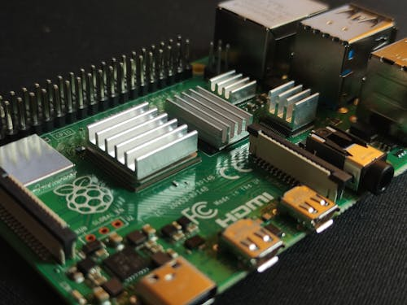
Signs You Should Start With Tuning Indexes - Technical
Any Poison Wait Types - RESOURCE_SEMAPHORE, THREADPOOL ?
As memory & CPU use increases, less and less resource available for next query
Is SOS_SCHEDULER_YIELD wait type “high”?
Parallelism, long running query tasks shuffled from CPUs back to work queues
Are there “high” Lock & Latch Waits?
Too many indexes, lots of table and index scanning, lock escalations
Notes:
05:00
YES answer is BAD
RESOURCE_SEMAPHORE - unable to get requested memory to execute query
THREADPOOL - no available threads in the server’s thread pool, CPU is MAX busy

Slide 16

Signs You Should Start With Tuning Indexes - Technical
Does CPU usage grows exponentially as users grow linearly?
Query executions are getting in each others way
Have indexes not been tuned in recent memory?
Pretty much the universal condition. A key component of Technical Debt
Performance “fixed” by missing index recommendations or Data Tuning Advisor?
Leads to a lot of redundancy
Notes:
05:00
YES answer is BAD

Slide 17

Client Story - Answers - Yes is Bad
Does CPU usage grows exponentially?
YES! CPU pegs 100% regularly
Any Poison Wait Types?
YES! Poison waits even with low load
Are there “high” Lock & Latch Waits?
YES! Wait types grow exponentially
Is SOS_SCHEDULER_YIELD wait type “high”?
YES! Especially when things get busy
Have indexes not been tuned recently?
YES! Can’t remember when was last done
Performance fixed with missing indexes?
YES! Client’s “goto” performance solution
Notes:
All answers are “YES” - 6 out of 6 on the technical scale
12 out of 12 indicators to start with indexes
Particular note: Developers has free reign to add missing index recommendations

Slide 18

New Index Tuning Approach - SQLXL_Index
Pareto’s Law (or the “80/20 Rule”)
“80% of results come from 20% of effort”
Ask SQL Server “Where does it hurt?”
Prioritize the hurts
Review index prescriptions
Apply prescriptions to fix the hurts
Notes:
*10:00*
HURT = Costs to Create, Read, Update, Delete (“CRUD”) data in tables

Slide 19
Performance Hurt - SQL Metrics
Waits Locks Page splits Page merges Missing indexes Total writes | Buffer usage Read / write ratio Index scans Table lookups Forwarded fetches LOB
Notes:
*08:00*
60 metrics of measured HURT
Lumped into 12 broad categories
INCOMPLETE – Fulltext, columnstore, in-memory

Slide 20

Performance Hurt
Waits
Locks
Splits
Merges
Missing
Writes
Buffer
Read/Write
Scans
Lookups
Fetches
LOB
Index activity waited on another SQL resource
Measure: counts & time spent waiting on:
locks rowstore “logical” buffer cache actions
latches rowstore “physical” actions memory <-> disk
row groups columnstore actions
I/O, logs in-memory actions
Hurt: longer execution time
Notes:
08:30
Wait - not going to get into threads and scheduler

Slide 21

Performance Hurt
Waits
Locks
Splits
Merges
Missing
Writes
Buffer
Read/Write
Scans
Lookups
Fetches
LOB
Controls for transactional compliance with ACID requirements
Measure: counts
rowstore locks applied to pages, rows
rowstore lock promotions (row -> page -> partition -> table)
attempts, successes
fails = attempts – successes
columnstore locks
Hurt:
longer execution time
more I/O
Notes:
09:00
ACID - atomicity, consistency, isolation, durability

Slide 22

Performance Hurt
Waits
Locks
Splits
Merges
Missing
Writes
Buffer
Read/Write
Scans
Lookups
Fetches
LOB
Can’t fit inserted / updated data into existing data page
creates new page
splinters data between both pages
Measure: counts
index leaf & tree splits
LOBs pushed off-row
in-memory page & key splits
Hurt:
more I/O
more CPU
Notes:
09:30
column_value_push_off_row = to LOB storage

Slide 23

Performance Hurt
Waits
Locks
Splits
Merges
Missing
Writes
Buffer
Read/Write
Scans
Lookups
Fetches
LOB
Row deletion or column update frees up space
squeeze data pages together
emptied pages marked for cleanup
Measure: counts
index leaf & tree merges
LOBs pulled in-row
in-memory page & key merges
Hurt:
more I/O
more CPU
Notes:
10:00
column_value_pull_in_row = from LOB storage

Slide 24

Performance Hurt
Waits
Locks
Splits
Merges
Missing
Writes
Buffer
Read/Write
Scans
Lookups
Fetches
LOB
Suggestions from the SQL optimizer to improve a single query
Measure:
Count of times query executed
Query cost estimate
Estimated percent reduction in query cost
Hurt:
inefficient query execution
more I/O
more CPU
less available buffer cache
NOTE: comes with many limitations
Notes:
10:30

Slide 25

Missing Index Limitations (from Microsoft)
Only considers nonclustered, rowstore, disk-based indexes
No clustered, columnstore, XML, spatial, full-text, hash, unique, filtered, materialized views
Uses estimates from first optimization of a single query
Cleared for a table on DDL change or rebuild
First 600 only, any more ignored.
Suggested index key columns listed by table column creation order, not selectivity
No consideration for key column parameter sniffing
Metrics not update after actual execution(s)
Not weighted based on total number of times table was queried
Ignores internal tables (e.g. supporting full text & spatial indexes)
Ignores history tables (CDC, SVN, LDG)
Adds included columns to cover query, without weighing cost / benefit
No reference to existing indexes or previous recommendations - causes overlaps!
No suggestions for trivial query plans
Suggests missing index for imprecise and non-persisted computed columns
Only one from each query, even if several were suggested in plan XML
Queries with only inequality predicates have less accurate query cost
Does not consider existing nonclustered columnstore in deciding on a “missing” index
Notes:
11:00

Slide 26

Performance Hurt
Waits
Locks
Splits
Merges
Missing
Writes
Buffer
Read/Write
Scans
Lookups
Fetches
LOB
Page changes to table & index data
Measure: counts
inserts
updates
deletes
Hurt:
more I/O
more locking
Note: excludes
splits, merges
LOB
Notes:
11:30
Operations – number of times index touched, e.g. Loop Join

Slide 27

Performance Hurt
Waits
Locks
Splits
Merges
Missing
Writes
Buffer
Read/Write
Scans
Lookups
Fetches
LOB
Proportion of index/heap in the buffer cache
exclude in-memory objects (always 100%)
Measure: pages in memory/total reserved pages allocated
Hurt:
more I/O - physical reads
less memory available for queries and data cache
Notes:
12:00

Slide 28

Performance Hurt
Waits
Locks
Splits
Merges
Missing
Writes
Buffer
Read/Write
Scans
Lookups
Fetches
LOB
“Gooder” indexes are read way way more than written
Benchmark: read > 4X writes because writes add:
Transaction Locks & Exclusive Latches
Uniquifiers/RIDs (Row IDentifiers)
Sequence/identity generation
Splits & merges
Deletes & Ghost cleanup
Log file writes
Data file writes
Change/History Table inserts
Replica synching
Measure: count of reads / writes
Hurt: much pain for little gain
Notes:
12:30

Slide 29
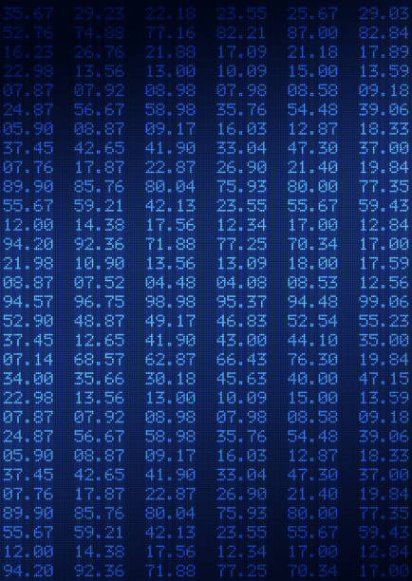
Performance Hurt
Waits
Locks
Splits
Merges
Missing
Writes
Buffer
Read/Write
Scans
Lookups
Fetches
LOB
Start at the top and read all pages
until you hit bottom
or TOP (###) - if index keys match
Measure:
count of range scans
Note: Columnstore is scan only
Hurt:
more I/O
less memory available for queries and data cache
Notes:
13:00
“Better” indexes get ”Seeked” - still may involve scan from that point
Or TOP (###) - if index keys match ORDER BY columns

Slide 30

Performance Hurt
Waits
Locks
Splits
Merges
Missing
Writes
Buffer
Read/Write
Scans
Lookups
Fetches
LOB
Index keys & included columns don’t “cover” query needs
extra seek(s) to data row
Measure: count of Lookups
Hurt:
more I/O
more locking
Notes:
13:30
“Better” indexes get ”Seeked” - still may involve scan from that point

Slide 31

Performance Hurt
Waits
Locks
Splits
Merges
Missing
Writes
Buffer
Read/Write
Scans
Lookups
Fetches
LOB
Heap Table - updating record causes page split
data physically moved out of original insertion sequence
Measure: count of forward fetched rows
Hurt:
more I/O - additional read(s) required to follow forwarding record pointer to moved page
more locking
Notes:
14:00
corrected by creating clustered index -or- table rebuild

Slide 32

Performance Hurt
Waits
Locks
Splits
Merges
Missing
Writes
Buffer
Read/Write
Scans
Lookups
Fetches
LOB
Big data types
TEXT, NTEXT
IMAGE
VARCHAR(MAX), NVARCHAR(MAX)
VARBINARY(MAX)
XML
Maintained in off-row pages
separate data allocation units
extra maintenance for pointers
Measure: count of LOB page touches
Hurt: more I/O
Notes:
*10:00*
Special data allocations: LOB_DATA & ROW_OVERFLOW_DATA

Slide 33
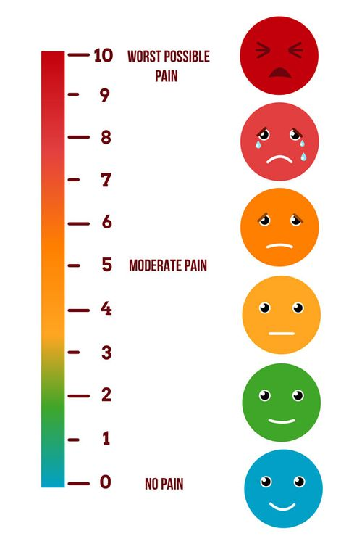
Prioritizing Hurt
For each hurt metric
Total by table
Total by instance (or single database)
Compute table’s percent of instance total
Some hurts more important than others
Apply weighting factor to metrics
Total up all weighted metric fractions by table
Present results in descending order of hurt
Notes:
20:00
90 hurt metrics
Why by table - it’s where the data lives

Slide 34

Weighting the Hurt - Current Defaults*
Waits ++++++
Locks +++
Splits +++++
Merges +++++
Missing ++++
Writes +++
Buffer +++++
Read/write ++++
Scans ++++
Lookups ++
Fetches +++
LOB +
* Runtime parameters
Notes:
13:00
Parameterized in SQLXL_Index
19 different values
Reflect your server’s operational metrics
Aggregated to Table level
<BS> Reads don’t include index seeks!

Slide 35

Client Story - Priority Findings
82% of hurt
4% of tables
Notes:
*22:00*
21 tables
Stunning insight - a lot less work to make significant improvement in performance
YMMV

Slide 36
Notes:
Sample Data - Microsoft’s WideWorldImporters
Run SQLXL_Index
Display in Excel - Automagically transferred to Excel via macros and ADODB connection
Dropdown - select columns displayed- 258 columns at last count
Out of 90+ - 24 principal table hurt metrics, computed as percent of instance/database
For each table
Columns highlighted “good” green to “bad” red
not all good or all bad

Slide 37

Notes:
Sample Data - Microsoft’s WideWorldImporters_FULL
OrderLines is 30% wait time 8% wait count – fewer longer

Slide 38
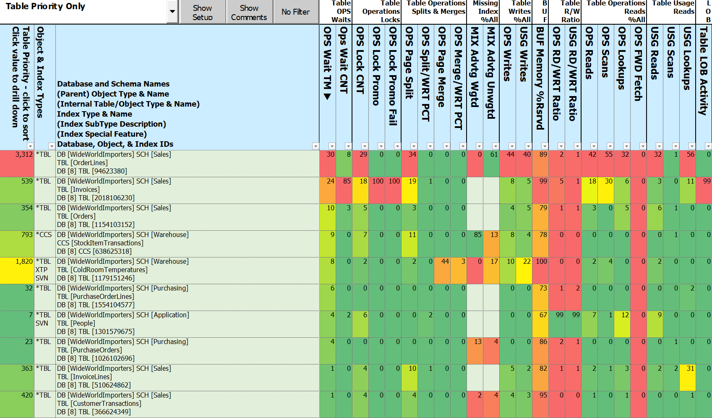
Notes:
So hurt can be spread unevenly across the pain metrics
Invoices is 24% wait time 85% wait count – more shorter

Slide 39

Client Story - SQLXL_Index Priority Findings
The priority tables make sense, but …
What do we need to do to make the hurt go away?
Need specific, actionable prescriptive actions
Based on metrics and diagnostics
At the individual index level

Slide 40

Prescription Development - Legacy Approach
If you are lucky ☺ - your monitoring tool may have some answers
If not, lots of SQL community scripts available
Download & execute each script in SSMS
Copy/paste each result set to spreadsheet(s)
Try grouping your results by index and table
By line decide what action is appropriate
Make sure to include the “It Depends” factors
Create & run scripts
Notes:
Others tell you “the patient is bleeding” not “what wound do you close first?”
It depends – low usage index covering a unique constraint

Slide 41

Prescription Development - New Approach
Execute SQLXL_Index in SSMS
Execute macro to return data to Excel
Click on the table(s) with most hurt
Review index prescriptions
Create & run scripts

Slide 42

SQLXL_Index - Prescriptions
97 table and index-level prescriptions
Grouped in 8 action categories
Notes:
*24:00*
What are the 8 things you can do the indexes on a table?

Slide 43
SQLXL_Index - 97 Prescriptions
Retain Replace Request Reject | Remove Review Refresh Refactor
Notes:
28:00

Slide 44
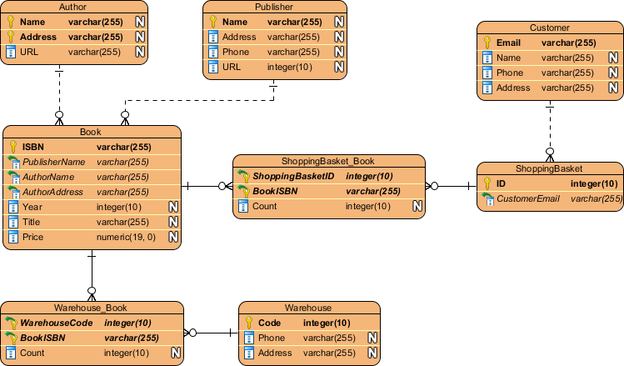
Prescription Categories
Retain
Replace
Request
Reject
Remove
Review
Refresh
Refactor
Existing indexes “As Architected & Designed”
Clustered
Constraints - primary key, unique, foreign key
History - Change Data Capture, System Versioned, Ledger
Special indexes - full-text, spatial, XML, columnstore
Required by others - unique index supporting a full-text index
Notes:
Purpose built indexes

Slide 45

Prescription Categories
Retain
Replace
Request
Reject
Remove
Review
Refresh
Refactor
New feature in SQL 2016+ Enterprise
Replace existing nonclustered rowstore indexes with updatable nonclustered columnstore
Low usage nonclustered rowstore
Low read/write ratio
Alternative for missing indexes

Slide 46

Prescription Categories
Retain
Replace
Request
Reject
Remove
Review
Refresh
Refactor
New Index
Clustered indexes on used heaps
Covers for foreign key constraints
Valuable missing indexes
Nonclustered columnstores

Slide 47

Prescription Categories
Retain
Replace
Request
Reject
Remove
Review
Refresh
Refactor
Missing index recommendations
That don’t add significant value
Table has / will have nonclustered columnstore
Notes:
Especially once weighted by share of reads

Slide 48

Prescription Categories
Retain
Replace
Request
Reject
Remove
Review
Refresh
Refactor
Existing indexes
Cost more than benefit - less than 4 reads per write
Duplicate - Least used
Redundant foreign key constraint
Notes:
Same keys different sequence (“overlap”)
Keys “contained” in another bigger index

Slide 49

Prescription Categories
Retain
Replace
Request
Reject
Remove
Review
Refresh
Refactor
“It Depends” for indexes tagged previously - such as:
Non-persisted computed column in index
High page compression failures
Potential filtered index - wide range of rows per lead index key
Potential temporary based on name

Slide 50

Prescription Categories
Retain
Replace
Request
Reject
Remove
Review
Refresh
Refactor
Statistics on indexes with
Stats row modifications
Stats row count not matching table row count
Rebuild/organize columnstores
with delta stores

Slide 51

Prescription Categories
Retain
Replace
Request
Reject
Remove
Review
Refresh
Refactor
Retained indexes benefiting from structural changes like:
Clustered rowstore index not “NUSE”
Narrow, Unique, Static, Ever increasing
Nonclustered rowstore index - additional key(s) don’t improve selectivity
FILL FACTOR = 100% and hi page splits

Slide 52

Client Story - Priority Prescription Implementation
Build “prior week” baseline statistics
Apply prescriptions on 4% of tables (21)
Restart server
Capture new statistics
Compare week over week results
Note: “mostly similar” non-peak workloads
Notes:
37:00
Fixes applied & server restarted

Slide 53

Client Story – SQL Wait Improvements versus Previous Week
RESOURCE_SEMAPHORE -71%
THREADPOOL -67%
SOS_SCHEDULER_YIELD -63%
LCK_* & PAGELATCH_* -52%
Notes:
YMMV

Slide 54

Client Story – Index Hurt Improvements versus Previous Week
Waits - times & counts -77%
Locks - count, promotions -62%
Scans & lookups -58%
Read / Write ratio -47%
Writes -43%
Splits, merges, push off / pull in -39%
Buffer cache usage - 0%
Notes:
Fixes applied & server restarted

Slide 55
Notes:
Dashboard
Getting to the Action
Click on Table Level priority
Display changes to Index details

Slide 56
Notes:
SAMPLE DATA
Sorted by index type, Foreign Key, Missing Indexes, History tables, Internal Tables
Sorting available on column heads
Enable Optimize for Sequential key new in 2019

Slide 57
Notes:
Optimize for Sequential Key – New in 2019, “can” speed up inserts into tables with identity or sequence clustered index

Slide 58

SQLXL_Index Diagnostics - Sourcing
89 DMVs & DMFs, 940 columns
182 operational metrics - sizes, stats, waits, locks, splits/merges, reads, writes, …
Around 38 seconds to collect & process on client server
Notes:
40:00
How did we come up with prescriptions? We diagnosed the symptoms.

Slide 59
SQLXL_Index Metadata & Metric Sources
Server Database=> @@ Functions DBCC TRACESTATUS msdb.sys.availability_replicas msdb.sys.change_tracking_databases msdb.sys.database_scoped_configurations msdb.sys.databases msdb.sys.dm_db_index_operational_stats msdb.sys.dm_db_index_usage_stats msdb.sys.dm_db_missing_index_columns msdb.sys.dm_db_missing_index_details msdb.sys.dm_db_missing_index_group_stats msdb.sys.dm_db_missing_index_group_stats_query msdb.sys.dm_db_missing_index_groups msdb.sys.dm_exec_query_plan msdb.sys.dm_exec_query_stats msdb.sys.dm_exec_sessions msdb.sys.dm_exec_sql_text msdb.sys.dm_hadr_availability_replica_states msdb.sys.dm_os_buffer_descriptors msdb.sys.dm_os_sys_info msdb.sys.servers SERVERPROPERTY Function | cdc.change_table sys.allocation_units sys.change_tracking_tables sys.check_constraints sys.column_store_row_groups sys.column_type_usages sys.columns sys.computed_columns sys.data_spaces sys.database_automatic_tuning_options sys.database_files sys.database_query_store_options sys.database_scoped_configurations sys.default_constraints sys.dm_db_column_store_row_group_operational_stats sys.dm_db_column_store_row_group_physical_stats sys.dm_db_incremental_stats_properties sys.dm_db_partition_stats sys.dm_db_stats_properties sys.dm_db_xtp_hash_index_stats sys.dm_db_xtp_index_stats sys.dm_db_xtp_memory_consumers sys.dm_db_xtp_Nonclustered_index_stats sys.dm_db_xtp_object_stats sys.dm_db_xtp_table_memory_stats sys.dm_sql_referencing_entities sys.dm_xtp_system_memory_consumers sys.edge_constraint_clauses sys.edge_constraints sys.extended_properties sys.filegroups sys.foreign_key_columns sys.foreign_keys sys.fulltext_catalogs | sys.fulltext_index_catalog_usages sys.fulltext_index_columns sys.fulltext_indexes sys.function_order_columns sys.hash_indexes sys.identity_columns sys.index_columns sys.index_resumable_operations sys.indexes sys.internal_partitions sys.internal_tables sys.key_constraints sys.objects sys.partition_functions sys.partition_schemes sys.partitions sys.schemas sys.sequences sys.spatial_index_tessellations sys.spatial_indexes sys.sql_expression_dependencies sys.sql_modules sys.stats sys.stats_columns sys.table_types sys.tables sys.triggers sys.types sys.views sys.xml_indexes sys.xtp_memory_consumers sys.xtp_Nonclustered_index_stats sys.xtp_object_stats

Slide 60

SQLXL_Index - 451 Diagnostics (SQL version aware)
“Good to know” - like
“Key” configuration properties
server, instance, database, query store …
Dates: Last read / written / modified / created / statistics updated …
Items that “stand out” - like
Non-default properties, settings, parameters
High proportion of a hurt or other metric
e.g. waits, locks, splits, merges
Anti-Patterns - like
Big included columns
Uncovered foreign keys
with missing index recommendations
Notes:
*41:00*
Non-Default - Cost threshold for Parallelism
History and Internal Tables given a pass (mostly)
Version Aware - don’t ding SQL 2012 for new feature in SQL 2022
Link to BlitzIndex when same item found (57 items)

Slide 61
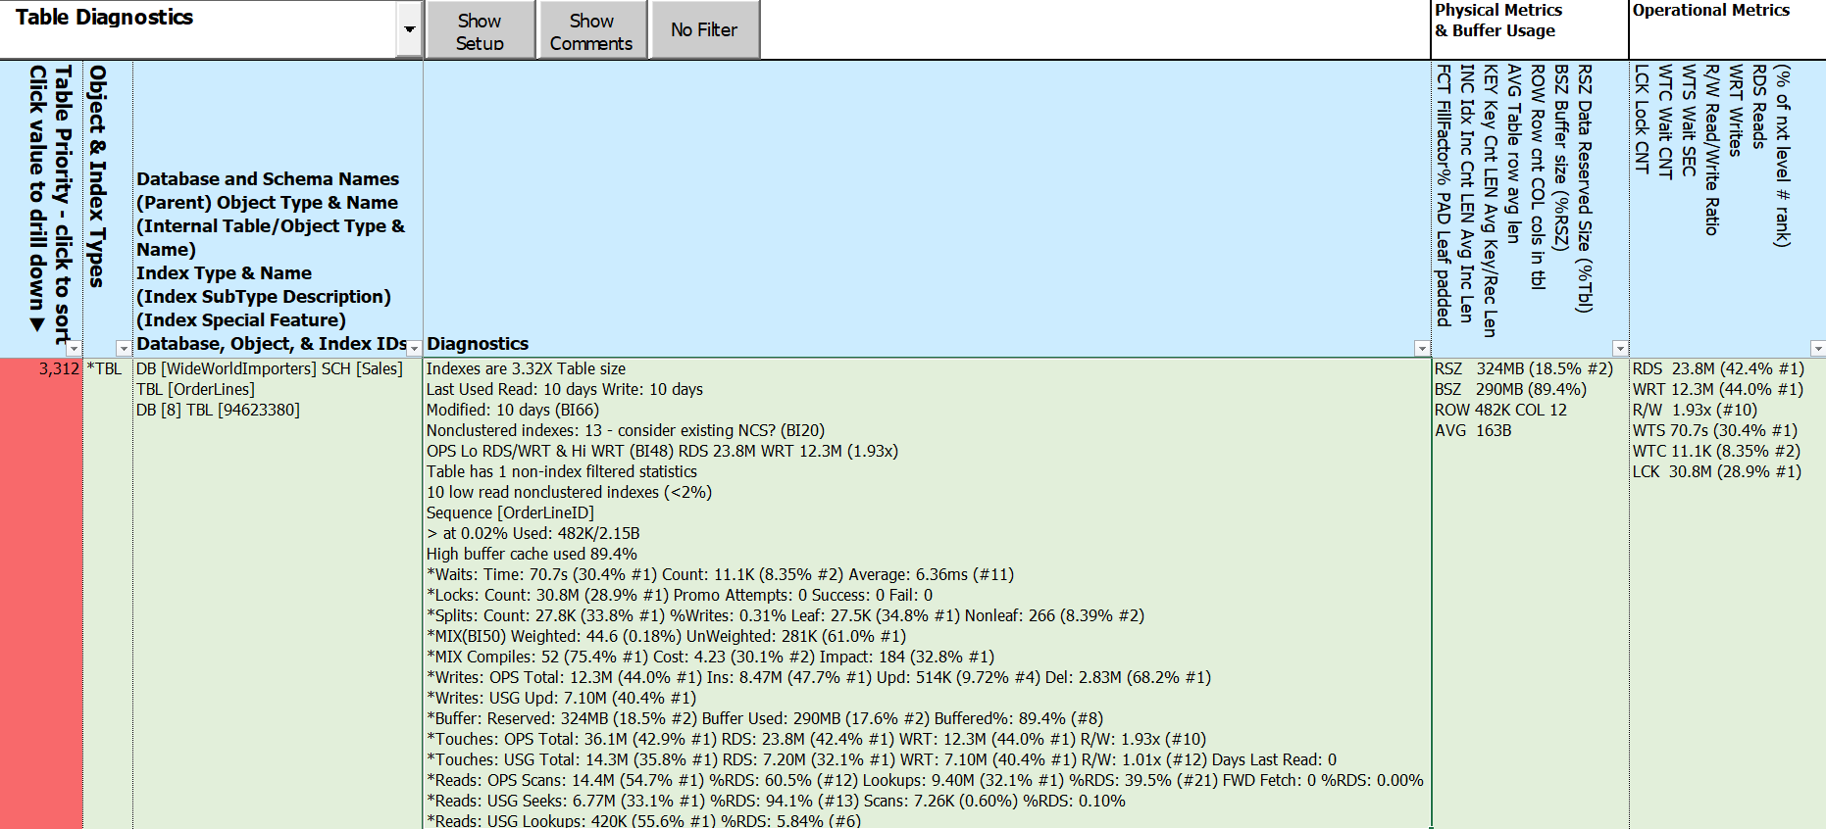
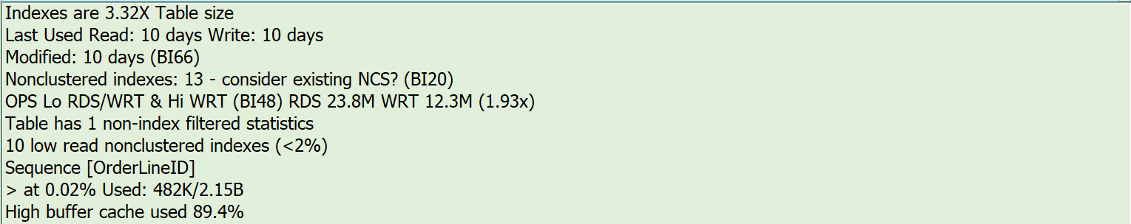
Notes:
Diagnostics split into 2 elements
Things to know
High pain metrics and related values – top values only
Trying to eliminate scrolling to “see” all of the key information
BlitzIndex Checks (BI##)

Slide 62
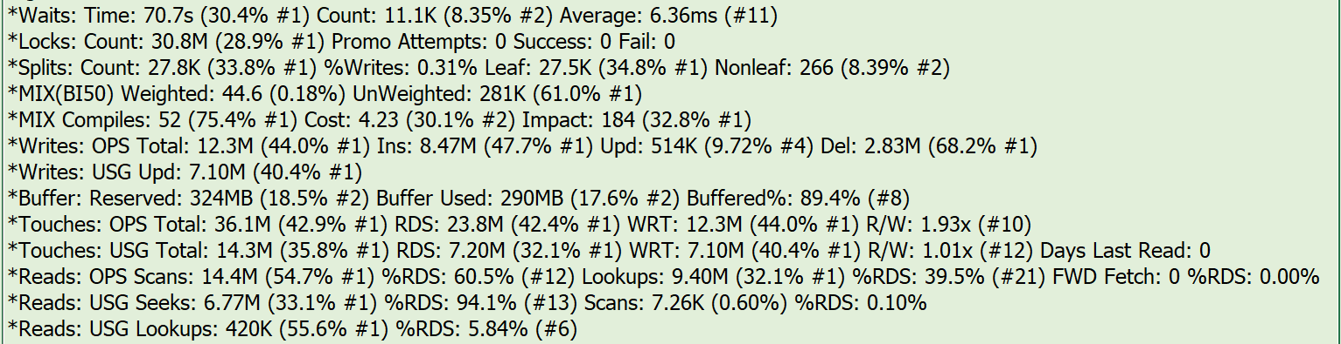
Notes:
Hurts & related metrics
3 elements per hurt - metric type, metric total, percent instance, ranking

Slide 63
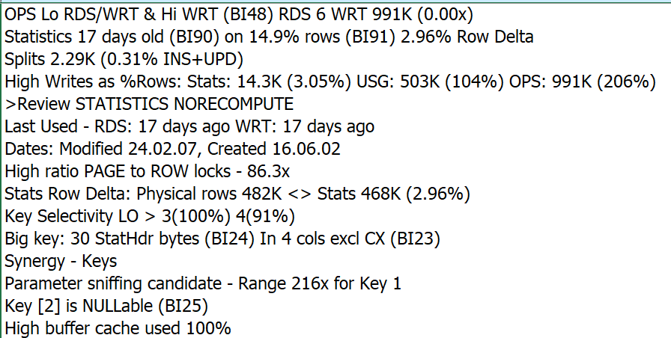
Notes:
Nonclustered Rowstore
To be replaced by existing NCS
BlitzIndex Checks (BI##)

Slide 64
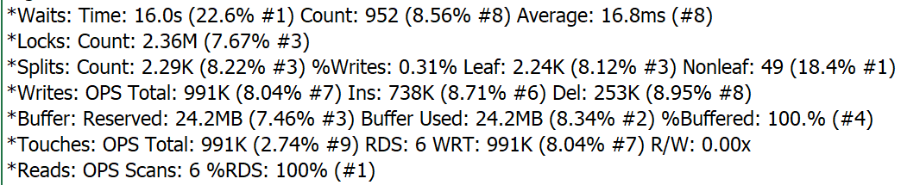
Notes:
Selected priority columns

Slide 65

What about Index Metadata and Other Metrics?
It’s in the spreadsheet
258 columns - details on
Foreign key constraints
Table & column constraints
Statistics names and filter definitions
Extended properties
All usage metrics
All Operational metrics
including in-memory & columnstores
Metadata - index, table, database, instance
Notes:
45:00

Slide 66
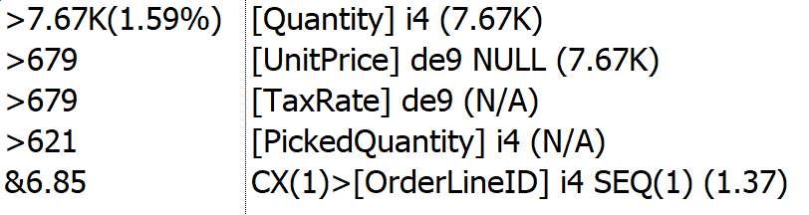
0.00%
- 8.54%

Slide 67
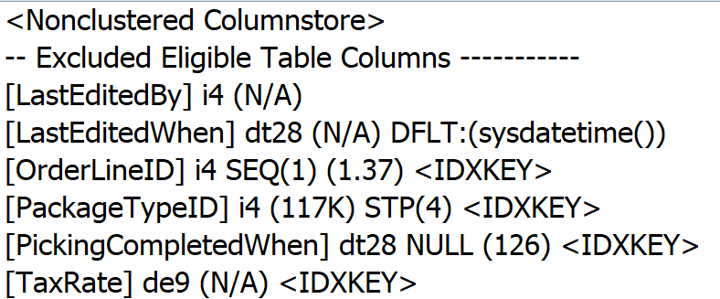

Slide 68

Implementing Index Fixes - Preparation
Clone structure of target database
Apply changes to clone to produce prescribed “end state”
Create delta scripts using favorite DDL comparison tool: target -> ”end state”
Scripting DDL changes best left to “experts”
Create “rollback code” by comparing in the opposite direction
Plan for lots of log file
Use Incrementalism
Consider DISABLE before dropping
Notes:
48:00
Depending on where problem occurs at what stage in the process, rollback code may be incomplete
Many DDL comparison tools batch up all related activities - can be difficult to unwind if failure

Slide 69

Implementing Index Fixes - Application
Apply delta scripts to target database
Re-compare “end state” to target database
Address any discrepancies
Execute rollback code if SHTF
*IMPORTANT* Batch changes by table
More time to script & execute
Expedites (inevitable) rollbacks
Notes:
*50:00*
Depending on where problem occurs at what stage in the process, rollback code may be incomplete
Many DDL comparison tools batch up all related activities - can be difficult to unwind if failure

Slide 70

Client Story - They Lived Happily Ever After
Good News - Even bigger event SQL CPU max 32%, no issues reported
Even more better - No performance complaints!
Completed most of the remaining index prescriptions, including:
Replace least-used indexes with nonclustered columnstores
Remove indexes not adding value
Request high-value missing indexes, heap clustered indexes, foreign key covers
Notes:
50:00

Slide 71

Free Stuff!
All T-SQL code, Excel workbook, & this presentation on Github
Up to 8 hours free consulting!
Notes:
52:30

Slide 72

Looking for Volunteers to help improve SQLXL_Index
Identify edge cases
Bug hunts & error handling
Tables - history (CDC, SVN, LDG), graph, internal
Azure - SQL Database, SQL Managed Instance
Special indexes - XML, full-text, spatial, hash
SQL table valued functions (TVF)
Additional execution parameters
Labeling, cell comments, and navigation
Documentation (what’s that?)
Operations
Notes:
52:30

Slide 73

Summary
Tuning indexes is a likely starting point for improving performance
SQL Server lets us know where to concentrate our efforts
Prioritize your index tuning - biggest bang for smallest buck
Actionable prescriptions make tuning decisions simpler
Incremental changes can minimize unforeseen outcomes
You can help improve SQLX_Index!
Notes:
53:30

Slide 74

Special thanks to these and other SQL community contributors!
Brent Ozar Kevin Kline Jes Borland Tom Collins Erik Darling Glenn Berry Gail Shaw Pedro Lopes | Tim Ford Sean McCown Kendra Little Pinal Dave Phil Factor Kalen Delaney Jason Strate Jared Westover | Grant Fritchey Andy Yun Paul Randall Kimberly Tripp Edward Pollack Ahmad Yaseen Ola Hallengren Denny Cherry | Aaron Bertrand Jonathan Kehayias Dmitri Korotkevitch Niko Neugebauer Monica Rathbun Kendall vanDyke Thomas LaRock Torsten Strauß
Notes:
Shout out to these and others whose community contributions went into this presentation
Future Adds:
Jared Westover
Pedro Lopes (MS)

Slide 75

Questions?
Notes:
*54:00*
Questions?

Slide 76
Session Evaluations
Your feedback is important to us!
Please fill out and hand to speaker after the session!

Slide 77
Event Evaluation
Fill out event evaluation card in your bag and visit all sponsors to be entered to win an Xbox Series X
Must be present to win!

Slide 78

Thanks for coming!
Bill Sanscrainte
linkedin.com/in/billsanscrainte & Bill@Sanscrainte.com
Presentation, spreadsheet, & T-SQL @ https://github.com/SQLXL/SQLXL
Also See:
Brent Ozar’s sp_BlitzIndex
Glenn Berry’s 89 (2022) Diagnostic Information Queries
Aaron Bertrand’s 40 table property queries
Expert Performance Indexing in Azure SQL and SQL Server 2022 (Great Book!)
Link to sp_Blitz_Index Checks:
https://github.com/BrentOzarULTD/SQL-Server-First-Responder-Kit/blob/dev/Documentation/sp_BlitzIndex_Checks_by_Priority.md
Notes:
59:30

Slide 79
Index (x): Prescriptions for Performance Improvement
Find presentation, Excel spreadsheet, & T-SQL code at
https://github.com/SQLXL/SQLXL
SQL Saturday Jacksonville 2024
Bill Sanscrainte
Bill@Sanscrainte.com
Notes:
*00:00*

Slide 80

Please fill out the Session Evaluation!
Notes:
*59:00*
Session Evaluations

